Slide 1



Python 3 Beginner
Chapter 00
Previously, on Python 3 Beginner…
release 1.0.0
37/39 Avenue Ledru Rollin – CS 11237 – 75750 PARIS CEDEX 12 - info@valnaos.com – www.valnaos.com Tél : 01 86 95 20 48

Slide 2

What we saw last time
Python 3 Beginner
The Python interpreter and how to use it in Google Colab
Displaying text with the print function
Capturing text from the user using the input function
Numeric types int, float and complex and mathematical operators.
Text type str, indexing and ranges with [], and format strings
Converting from one type to another

Slide 3

Cloud Technology Associate
Copyright © 2018 | 9
Q&A
37/39 Avenue Ledru Rollin – CS 11237 – 75750 PARIS CEDEX 12 - info@valnaos.com – www.valnaos.com Tél : 01 86 95 20 48

Slide 4

Where? Who?
Python 3 Beginner
Class Material
GitHub: https://github.com/cstar-industries/python-3-beginner
Instructor
Charles Francoise <charles@cstar.io>

Slide 5
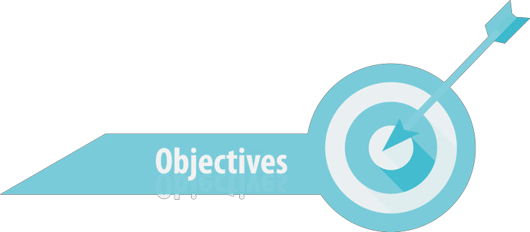
Session Objectives
Python 3 Beginner
At the end of this session, you will be able to:
Compare values and logically combine comparison results
Manipulate lists of objects with a new, powerful datatype
Conditionally execute or skip code
Iterate over lists, strings and number sequences
Loop over code until a condition is met
Use some powerful built-in tools from the Python language to make iteration simple and expressive

Slide 6
Session Syllabus
Python 3 Beginner
Chapter | Subject | Start | End | Total Time (in hours)
00 | Previously on Python 3 Beginner… | 14:00 | 14:30 | 00:30
01 | Boolean type and comparison operators | 14:30 | 15:15 | 00:45
02 | Conditionals: if – else | 15:15 | 15:45 | 00:30
 | Coffee Break | 15:45 | 16:00 | 00:15
03 | Loops Part I: Iteration / list – for – range | 16:00 | 16:30 | 00:30
04 | Loops Part II: Conditional / while | 16:30 | 16:40 | 00:10
05 | Mastering loops and control flow | 16:40 | 17:00 | 00:20
 | Coffee Break | 17:00 | 17:15 | 00:15
 | Workshop: mastering control flow | 17:15 | 18:00 | 01:00
 | Total |  |  | 04:00

Slide 7
Python 3 Beginner
Chapter 01
Boolean type and comparison operators
release 1.0.0
37/39 Avenue Ledru Rollin – CS 11237 – 75750 PARIS CEDEX 12 - info@valnaos.com – www.valnaos.com Tél : 01 86 95 20 48

Slide 8
Representing “nothing” in Python
Python 3 Beginner
Special datatype NoneType
Only one value: None
Used to represent the absence of a value (e.g. when a function returns nothing)
Similar to null or void in other languages
a = None
print(a)
None

Slide 9
Boolean type
Python 3 Beginner
bool is a type to contain the Boolean notion of truth
Two possible values: True/False (watch out for the capitals!)
Use the not operator to negate the value
 | False | True
not | True | False

Slide 10
Boolean operators
Python 3 Beginner
Boolean values can be combined using Boolean arithmetic operators: and / or
and | False | True
False | False | False
True | False | True
or | False | True
False | False | True
True | True | True

Slide 11
Boolean operators
Python 3 Beginner
Just like mathematical and string operators, Boolean operators can be prioritized by parentheses
Watch out for unexpected operator precedence effects! When in doubt, always make your intent explicit with parentheses.
⚠️
👍
print(True or True and False)
print(True or (True and False))
False
True

Slide 12
Let’s write some code!
Python 3 Beginner
print(False or False)
print(False or True)
print(True or False)
print(True or True)
False
True
True
True
Notes:
* The `print` function outputs whatever we tell it to

Slide 13
Comparison operators
Python 3 Beginner
Comparison operators generate a Boolean value by comparing two values
Equality: == / Inequality !=
Greater than: > / Lower than: <
Greater than or equal: >= / Lower than or equal: <=
print(1 == 2)
print(1 < 2)
print('toto' == 'toto')
False
True
True

Slide 14
More comparison operators
Python 3 Beginner
Identity: is / is not
Inclusion: in / not in
a = 'Hello World!'
print('x' in a)
print('W' in a)
b = 'Hello World!'
print(a == b)
print(a is b)
False
True
True
False

Slide 15
Complex boolean expressions
Python 3 Beginner
Combine comparison results with boolean operators
a = 13
(a > 0) and ((a % 2) == 0)
False
Chain comparison operators left to right
x op1 y op2 z ⬄ (x op1 y) and (x op2 z)
a = 13
0 < a < 15
True

Slide 16
Let’s write some code!
Python 3 Beginner
a = 'Hello World!'
b = 'Hello World!'
print(a == b)
print('h' in a)
print('H' in a)
print('Hell' in a)
True
False
True
True
Notes:
* The `print` function outputs whatever we tell it to

Slide 17
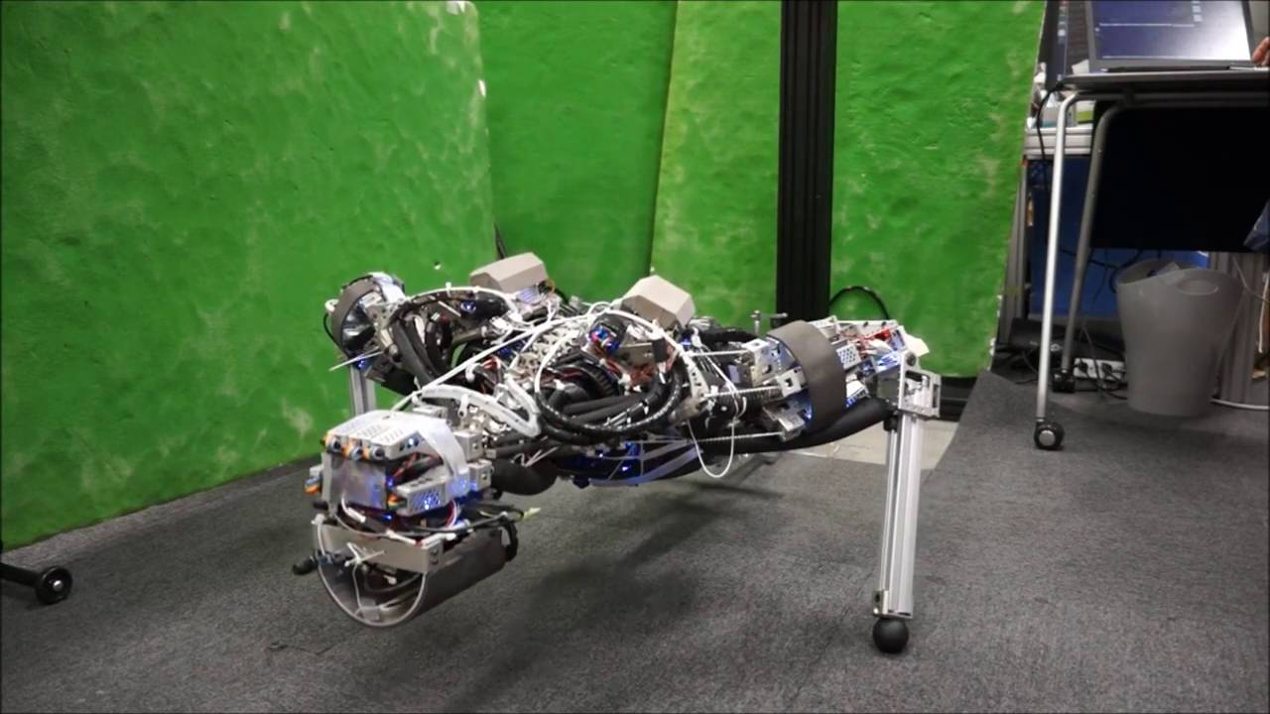
Workout Time!
Python 3 Beginner
Chapter 1 Exercises link
Notes:
https://github.com/cstar-industries/python-3-beginner/blob/master/001-First-Steps/First%20Steps%20-%20Chap%2001%20-%20Exercises.ipynb

Slide 18
Chapter Summary
Python 3 Beginner
This chapter covered the following:
NoneType and its only value None
bool type and its values True and False
bool operators not, and, and or
Comparison operators ==, !=, <, >…
Producing boolean values from comparisons and combining them with boolean operators

Slide 19
Python 3 Beginner
Chapter 02
Conditional Flow: if – else
release 1.0.0
37/39 Avenue Ledru Rollin – CS 11237 – 75750 PARIS CEDEX 12 - info@valnaos.com – www.valnaos.com Tél : 01 86 95 20 48

Slide 20
Conditional flow diagram
Python 3 Beginner
How do we display the absolute value of a number?

Slide 21
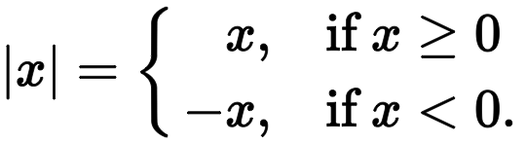
Conditional flow diagram
Python 3 Beginner
How do we display the absolute value of a number?

Slide 22
Conditional flow diagram
Python 3 Beginner
How do we display the absolute value of a number?
NO
is x negative?
x = -x
print(x)
YES

Slide 23
Conditional Flow in Python: if
Python 3 Beginner
The if keyword either runs or skips code based on a condition
x = int(input())
if x < 0:
x = -x
print(x)

Slide 24
Conditional Flow in Python: if
Python 3 Beginner
if condition:
Indentation is important in Python: use 4 spaces
x = int(input())
if x < 0:
∙∙∙∙x = -x
print(x)

Slide 25
Conditional flow diagram
Python 3 Beginner
print("even")
YES
Is x divisible by two?
NO
print("odd")

Slide 26
Conditional flow in Python: else
Python 3 Beginner
if condition: else:
Indentation: else must be aligned with corresponding if
x = int(input())
if (x % 2) == 0:
print("even")
else:
print("odd")

Slide 27
Chaining conditions: elif
Python 3 Beginner
if condition1: elif condition2: else:
x = int(input())
if x < 0:
print("negative")
elif (x % 2) == 0:
print("positive even")
else:
print("positive odd")

Slide 28
What constitutes a condition?
Python 3 Beginner
Any object can be tested for a truth value in an if statement.
By default, an object evaluates to True
The following values evaluate to False
constants defined to be false: None and False
zero of any numeric type: 0, 0.0, 0j, Decimal(0), Fraction(0, 1)
empty sequences and collections: "", (), [], {}, set(), range(0)

Slide 29
Let’s write some code!
Python 3 Beginner
x = 12
if (x % 2) == 0:
print(f"{x} is even")
print(f"{x}/2 = {x//2}")
else:
print(f"{x} is odd")
print(f"{x}/2 = {x/2}")
12 is even
12/2 = 6

Slide 30
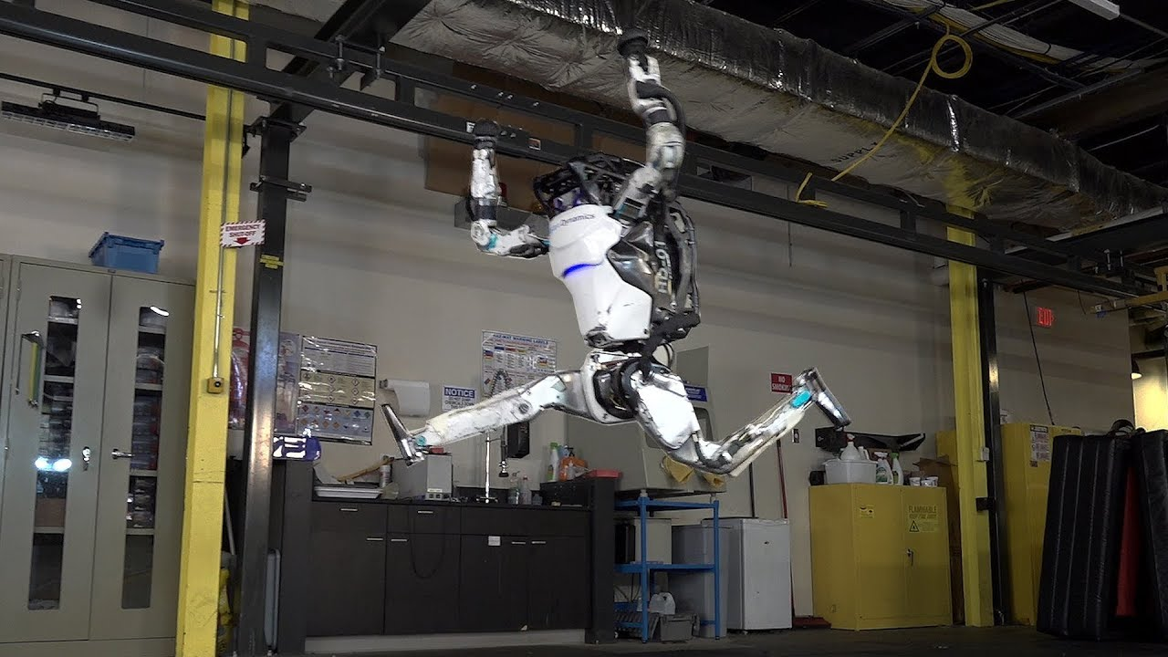
Workout Time!
Python 3 Beginner
Chapter 2 Exercises link
Notes:
https://github.com/cstar-industries/python-3-beginner/blob/master/001-First-Steps/First%20Steps%20-%20Chap%2002%20-%20Exercises.ipynb

Slide 31
Chapter Summary
Python 3 Beginner
This chapter covered the following:
The basics of conditional flow: if – else
Cascading conditions using elif
What is truth in Python?
Significant whitespace indentation rules in Python

Slide 32
Python 3 Beginner
Chapter 03
Loops Part I: Iteration
release 1.0.0
37/39 Avenue Ledru Rollin – CS 11237 – 75750 PARIS CEDEX 12 - info@valnaos.com – www.valnaos.com Tél : 01 86 95 20 48

Slide 33
A new datatype: list
Python 3 Beginner
An ordered list of objects
Similar to arrays or vectors in other languages
Written as a list of comma-separated values between square brackets
l = [1, 2, 3]
print(l)
l = ['one', 'two', 'three']
print(l)
[1, 2, 3]
['one', 'two', 'three']

Slide 34
A new datatype: list
Python 3 Beginner
Like str, list supports:
the len function
single-item indexing and ranges with []
l = ['a', 'list', 'of', 5, 'objects']
print(len(l))
print(l[0])
print(l[:3])
print(l[-2:])
a
['a', 'list', 'of']
[5, 'objects']

Slide 35
A new datatype: list
Python 3 Beginner
Like str, list supports:
concatenation with +
[1, 2] + [3, 4]
[1, 2, 3, 4]
repetition with *
5 * ['spam']
['spam', 'spam', 'spam', 'spam', 'spam']

Slide 36
A new datatype: list
Python 3 Beginner
Unlike str:
is mutable
l = [0, 1, 2]
l[2] = 3
print(l)
[0, 1, 3]
can contain objects of different types
[True, 'hello', int(6/2)]
[True, 'hello', 3]

Slide 37
Let’s write some code!
Python 3 Beginner
l = [1, 2, 3]
print(l)
l = ['one', 'two', 'three']
print(l)
[1, 2, 3]
['one', 'two', 'three']

Slide 38
Iteration control flow diagram
Python 3 Beginner
How can we print every character in a string?
print(s[0])
print(s[1])
print(s[2])
...

Slide 39
Iteration control flow diagram
Python 3 Beginner
How can we print every character in a string?
print(s[0])
print(s[1])
print(s[2])
...

Slide 40
Iteration control flow diagram
Python 3 Beginner
How can we print every character in a string?
for each character c in string s
print(c)

Slide 41
Iteration control flow diagram
Python 3 Beginner
How can we print every character in a string?
for each character c in string s
print(c)

Slide 42
Iteration in Python: for
Python 3 Beginner
for variable in iterable:
s = "Hello World!"
for c in s:
print(c)
H
e
l
l
o
W
...

Slide 43
Iteration in Python: for
Python 3 Beginner
for variable in iterable:
s = "Hello World!"
for c in s:
print(c)
H
e
l
l
o
W
...

Slide 44
Iteration in Python: for
Python 3 Beginner
lists are iterable
squares = [0, 1, 4, 9, 16, 25]
for x in squares:
print(math.sqrt(x))
0.0
1.0
2.0
3.0
4.0
5.0

Slide 45
Iteration in Python: for
Python 3 Beginner
iterate on a sequence of numbers: range
for x in range(10):
print(x)
0
1
2
3
4
5
6
7
8
9

Slide 46
Iteration in Python: for
Python 3 Beginner
range is a very versatile function
for x in range(10, 15):
print(x, end=' ')
10 11 12 13 14
for x in range(10, 15, 2):
print(x, end=' ')
10 12 14

Slide 47
Let’s write some code!
Python 3 Beginner
for n in [2, 4, 5, 7, 9, 10]:
if (n % 2) == 0:
print(f'{n} is even')
else:
print(f'{n} is odd')
2 is even
4 is even
5 is odd
7 is odd
9 is odd
10 is even

Slide 48
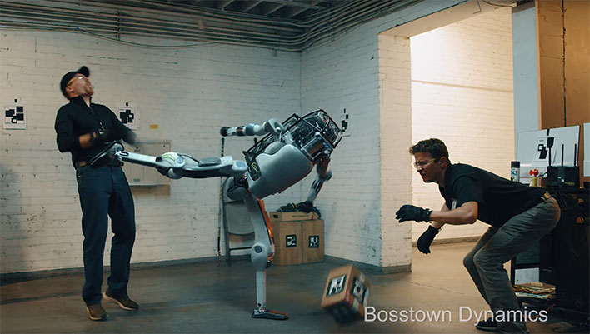
Workout Time!
Python 3 Beginner
Chapter 3 Exercises link
Notes:
https://github.com/cstar-industries/python-3-beginner/blob/master/001-First-Steps/First%20Steps%20-%20Chap%2003%20-%20Exercises.ipynb

Slide 49
Chapter Summary
Python 3 Beginner
This chapter covered the following:
A new, powerful data type: list
Iterating over sequences with for
Using range to generate sequences of numbers

Slide 50
Python 3 Beginner
Chapter 04
Loops Part II: while
release 1.0.0
37/39 Avenue Ledru Rollin – CS 11237 – 75750 PARIS CEDEX 12 - info@valnaos.com – www.valnaos.com Tél : 01 86 95 20 48

Slide 51
Conditional loop flow diagram
Python 3 Beginner
How can we ask a user to confirm a choice?
while the answer is not yes or no
ask the user if they wish to confirm their choice

Slide 52
Conditional loop flow diagram
Python 3 Beginner
How can we ask a user to confirm a choice?
while
answer != 'y' and answer != 'n'
answer = input('Are you sure? (y/n)')

Slide 53
Looping in Python: while
Python 3 Beginner
while condition:
answer = None
while answer != 'y' and answer != 'n':
answer = input('Are you sure? (y/n) ')
print(answer)
Are you sure? (y/n)
Are you sure? (y/n) g
Are you sure? (y/n) yes
Are you sure? (y/n) y
y

Slide 54
Looping in Python: while
Python 3 Beginner
while condition:
while True:
print('Hello World!')
Hello World!
Hello World!
Hello World!
Hello World!
Hello World!
Hello World!
Hello World!
Hello World!
Hello World!
...

Slide 55
Let’s write some code!
Python 3 Beginner
answer = None
while answer != 'y' and answer != 'n':
answer = input('Are you sure? (y/n) ')
print(answer)
Are you sure? (y/n) y
y

Slide 56
Chapter Summary
Python 3 Beginner
This chapter covered the following:
Using while to loop until a condition is true

Slide 57
Python 3 Beginner
Chapter 05
Mastering control flow
release 1.0.0
37/39 Avenue Ledru Rollin – CS 11237 – 75750 PARIS CEDEX 12 - info@valnaos.com – www.valnaos.com Tél : 01 86 95 20 48

Slide 58
"Short-circuiting" a loop
Python 3 Beginner
Exit the loop early with break
for n in [0, 1, 2, -1, 41]:
if n < 0:
print(f'invalid value: {n}')
break
print(math.sqrt(n))
0.0
1.0
1.4142135623730951
invalid value: -1

Slide 59
"Short-circuiting" a loop
Python 3 Beginner
Jump to the next iteration with continue
addr_list = ['charles@cstar.io', 'tim.apple.com', 'guido@python.org']
for addr in addr_list:
if '@' not in addr:
continue
send_email(addr) # Sending an email might take a while
print(f'E-mail sent to {addr}')
E-mail sent to charles@cstar.io
E-mail sent to guido@python.org

Slide 60
"Short-circuiting" a loop
Python 3 Beginner
break and continue also work with while loops
addr_list = ['charles@cstar.io', 'tim.apple.com', 'guido@python.org']
for addr in addr_list:
if '@' not in addr:
continue
send_email(addr) # Sending an email might take a while
print(f'E-mail sent to {addr}')
E-mail sent to charles@cstar.io
E-mail sent to guido@python.org

Slide 61
Loop else clause
Python 3 Beginner
Loops can have an else clause that is executed if the loop exits without breaking
for n in [0, 2, 4, 5, 6]:
if (n % 2) != 0:
break
print(f'{n} is even')
else:
print('All numbers are even')
0 is even
2 is even
4 is even

Slide 62
Iterating over value and index
Python 3 Beginner
Often, we need to iterate over a list while keeping track of the index
l = [0, 4, 25]
for i in range(len(l)):
print(f'Item at position {i} is {l[i]}')
Item at position 0 is 0
Item at position 1 is 4
Item at position 2 is 25

Slide 63
Iterating over value and index
Python 3 Beginner
Often, we need to iterate over a list while keeping track of the index
l = [0, 4, 25]
for i in range(len(l)):
print(f'Item at position {i} is {l[i]}')
Item at position 0 is 0
Item at position 1 is 4
Item at position 2 is 25

Slide 64
Iterating over value and index
Python 3 Beginner
Use enumerate to update both variables upon looping
l = [0, 4, 25]
for i, item in enumerate(l):
print(f'Item at position {i} is {item}')
Item at position 0 is 0
Item at position 1 is 4
Item at position 2 is 25

Slide 65
Iterating over multiple lists
Python 3 Beginner
We can iterate simultaneously over multiple lists using zip
for i, j in zip(range(5), range(10, 15)):
print(i, j)
0 10
1 11
2 12
3 13
4 14

Slide 66
Conditional expressions
Python 3 Beginner
We can return a single value depending on a condition in one simple expression
a = 13
b = a / 2 if (a % 2) == 1 else 'odd'
print(b)
odd

Slide 67
Workout Time!
Python 3 Beginner
Chapter 4-5 Exercises link
Notes:
https://github.com/cstar-industries/python-3-beginner/blob/master/001-First-Steps/First%20Steps%20-%20Chap%2003%20-%20Exercises.ipynb

Slide 68
Chapter Summary
Python 3 Beginner
This chapter covered the following:
Breaking out of loops early with break
Skipping a loop iteration using continue
Using enumerate to iterate over indexes and values of a sequence
Using zip to iterate over multiple loops at a time
Conditional expressions (also called the "ternary operator")

Slide 69
Cloud Technology Associate
Copyright © 2018 | 9
Q&A
37/39 Avenue Ledru Rollin – CS 11237 – 75750 PARIS CEDEX 12 - info@valnaos.com – www.valnaos.com Tél : 01 86 95 20 48

Slide 70

Workshop
Python 3 Beginner
Session 02 Workshop link
Notes:
https://github.com/cstar-industries/python-3-beginner/blob/master/001-First-Steps/First%20Steps%20-%20Workshop.ipynb

Slide 71
Thank you for your attention!

